Slide 1
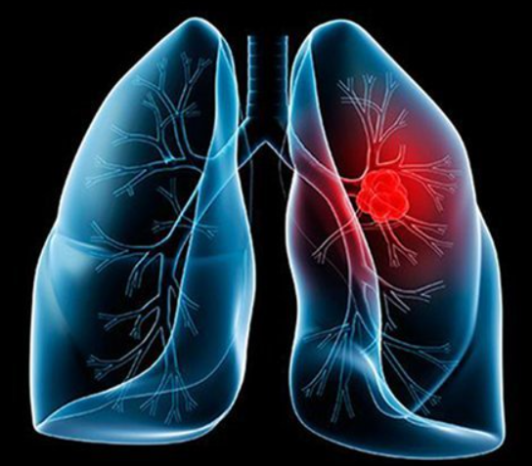
Lung Cancer Detection
Presented by
Saikat Sheet - 18700120024
Souvik Ghosh - 18700120031
Rajdip Manna - 18700120042
Sayak Pal - 18701620010

Slide 2
Lung Cancer
Cancer is a disease in which cells in the body grow out of control. When cancer starts in the lungs, it is called lung cancer.
Lung cancer may spread to other organs in the body. Cancer from other organs also may spread to the lungs. When cancer cells spread from one organ to another, they are called metastases.
There are two types of lung cancer:
1. Small Cell
2. Non-Small Cell

Slide 3
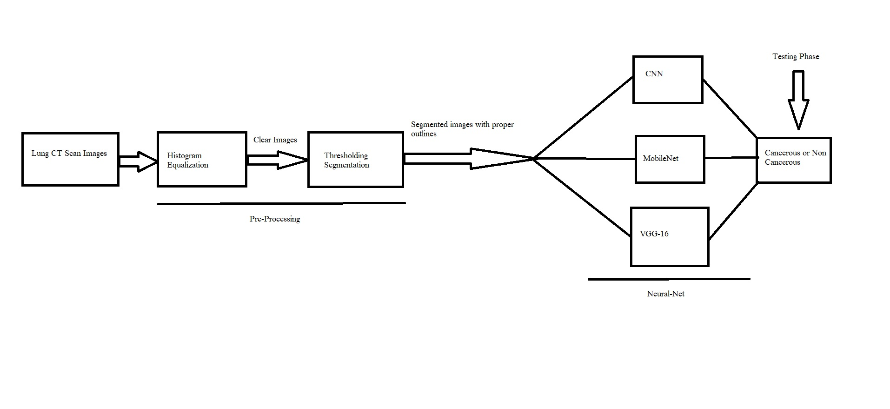
Methodology & Architecture
At first CT scan images are taken as dataset and the dataset contains three types of lung cancer images adenocarcinoma, large cell carcinoma, squamous cell carcinoma and non-cancerous lung images. For image pre-processing histogram equalization operation is performed on the dataset to get the clear images and thresholding segmentation operation is performed to get segmented images with proper outline. Thereafter CNN,MOBILENET,VGG-16 three deep learning model is trained and at last It will be checked which model is better in terms of detection and accuracy and based on that a scoreline will be given to each model.

Slide 4
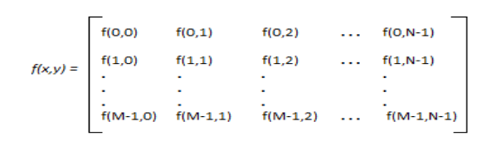
Image Processing
An Image is nothing but a 2-D Matrix. Image is defined by the function of x and y.
Image processing is the use of computer algorithms to manipulate digital images in order to enhance their quality or extract useful information from them. Practically, image processing can involve a wide range of applications.

Slide 5
Image Processing Steps
Image enhancement: This involves adjusting the brightness, contrast, and color balance of an image to make it more visually appealing or to highlight certain features.
Image restoration: This involves removing noise, blurring, or other artifacts from an image to improve its quality.
Image segmentation: This involves dividing an image into different regions or objects based on their properties, such as color, texture, or shape.
Object recognition: This involves identifying objects in an image and classifying them based on their characteristics.
Image compression: This involves reducing the size of an image while maintaining its visual quality, in order to save storage space or transmit it more efficiently over a network.
Medical imaging: This involves processing images from medical devices such as X-rays, MRI scans, or CT scans to help diagnose and treat medical conditions.

Slide 6
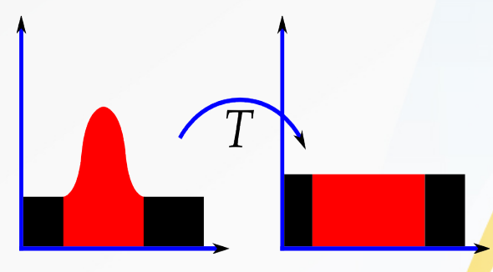
Histogram Equalization
Histogram equalization is a technique of image enhancement.This is used in digital image processing to adjust the contrast of an image.
Especially when the image is represented by a narrow range of intensity values then It works by redistributing the pixel values of an image so that the intensity values are spread out over a wider range, resulting in a more balanced distribution of pixel values.
As we need to analyze the distribution of pixel intensities in an image, the CDF is an important tool to get this done.

Slide 7
Segmentation
Segmentation refers to the process of dividing or breaking down something into smaller parts or segments. The term is used in various fields such as marketing, computer science, and biology, among others.
In image processing, segmentation refers to the process of dividing an image into multiple segments or regions, with the goal of identifying and separating objects or areas of interest.
The segmentation process is often used as a pre-processing step in various computer vision applications, such as object detection, tracking, and image analysis.

Slide 8
How segmentation is used in ML
Segmentation is used in machine learning (ML) to divide an image or dataset into meaningful and distinctive parts or segments, with the goal of improving performance and accuracy in various applications, such as image classification, object detection, and semantic segmentation.
In image classification, segmentation can be used to identify and separate objects or regions of interest within an image, and to extract features from these regions.
In object detection, segmentation can be used to generate candidate regions or proposals for object detection, and to classify these regions using ML algorithms.
In semantic segmentation, segmentation can be used to classify each pixel in an image according to its semantic meaning, such as object class or scene category.

Slide 9
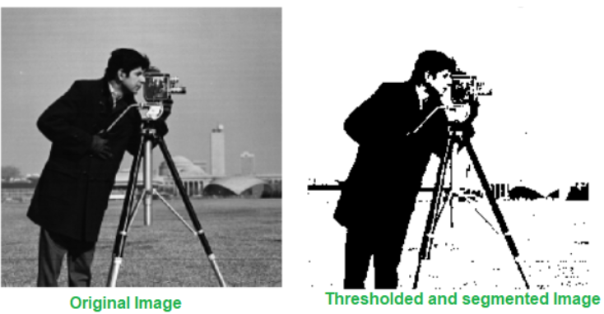
Threshold Segmentation
Thresholding segmentation is a technique used in image processing and computer vision to separate objects or regions of an image based on the intensity values of pixels.
The process involves setting a threshold value that separates the pixels into two categories - foreground and background.
Pixels with intensities above the threshold value are considered part of the foreground, while pixels with intensities below the threshold value are considered part of the background.
The threshold value can be set manually based on domain knowledge or it can be automatically determined using various techniques, such as Otsu's method or adaptive thresholding.
Thresholding segmentation is a simple yet effective technique for separating objects or regions of an image based on intensity values, and it can be used in various applications such as object recognition, image segmentation, and optical character recognition (OCR).
However, it may not be effective in cases where the intensity values of objects and background are not well separated, or when the image contains significant variations in lighting or contrast.

Slide 10
Uses of Threshold Segmentation
Threshold segmentation is a commonly used technique in machine learning (ML) for various applications such as image segmentation, object recognition, and feature extraction.
In image segmentation, thresholding is used to separate the image into regions of interest, such as objects or backgrounds. The resulting segmented image can then be used for further analysis or processing, such as object detection or feature extraction.
In object recognition, thresholding can be used to extract the object of interest from an image. This can be done by setting a threshold value that separates the object from the background, and then extracting features from the object using various ML techniques, such as support vector machines (SVMs) or convolution neural networks (CNNs).
In feature extraction, thresholding can be used to extract specific features from an image based on their intensity values. For example, in face recognition, thresholding can be used to extract the eyes or mouth from an image, which can then be used as features for recognition.
Overall, thresholding segmentation is a simple yet effective technique in ML for separating objects or regions of interest based on intensity values, and it can be used in various applications to improve performance and accuracy.

Slide 11
Model Training in Machine Learning
A machine learning training model is a process in which a machine learning (ML) algorithm is fed with sufficient training data to learn from.
A training model is a dataset that is used to train an ML algorithm. It consists of the sample output data and the corresponding sets of input data that have an influence on the output.
The training phase has a major impact on a machine learning model’ s performance – the quality and quantity of data fed into the model at the training stage determines the quality and efficacy of applications built with that model.

Slide 12
Factors for Model Training
Two important factors in the model training phase
The training dataset- labeled data samples that contain typical inputs the algorithm is expected to handle, together with the correct model output (the labels). A training dataset is usually partitioned into training, validation, and testing. The training dataset is used in initial training; validation data is used to evaluate the model and tune hyperparameters; and testing data is used to measure performance of the final model.
The training algorithm- there are multiple algorithms available for most machine learning tasks. There are trade-offs in determining the best algorithm, such as model complexity, interpretability, performance, and computational requirements. Each algorithm has its own training process and may have different training data requirements.

Slide 13
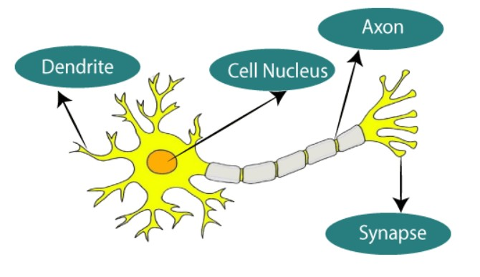
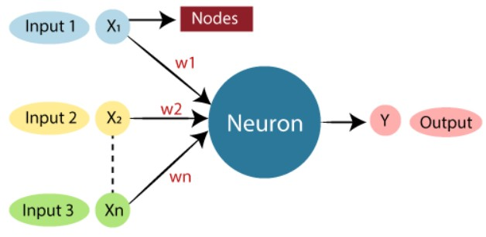
Artificial Neural Network
What is Artificial Neural Network?
The term "Artificial Neural Network" is derived from Biological neural networks that develop the structure of a human brain. Similar to the human brain that has neurons interconnected to one another, artificial neural networks also have neurons that are interconnected to one another in various layers of the networks. These neurons are known as nodes. An Artificial Neural Network in the field of Artificial intelligence where it attempts to mimic the network of neurons makes up a human brain so that computers will have an option to understand things and make decisions in a human-like manner. The artificial neural network is designed by programming computers to behave simply like interconnected brain cells.

Slide 14
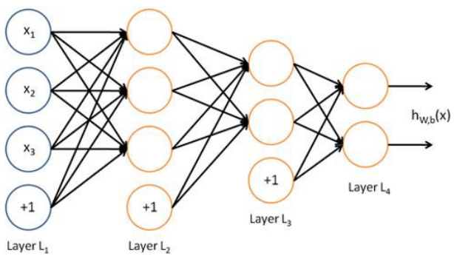
Architecture of Artificial Neural Network.
Input Layer: The input layer, which is the top layer of an ANN, is where input data in the form of letters, numbers, audio files, image pixels, etc. is first received.
Hidden Layer: The hidden layers are located in the center of the ANN model. One hidden layer, like in the case of a perceptron, or several hidden layers are both possible. On the input data, these hidden layers run a variety of mathematical operations and identify the patterns that are there.
Output Layer: The middle layer’s meticulous computations enable us to produce the desired result in the output layer.
ANN has a number of units arranged in a number of layers. A single unit is known as a Neuron. The input layer’s input units take in a variety of inputs from the outside environment. The data then travels to the hidden unit, which transforms it into a format that output units may use. A neuron begins by adding the values of all the neurons in the layer below it to which it is linked.

Slide 15
Use cases of Neural Network
Neural networks have several use cases across many industries, such as the following:
Medical diagnosis by medical image classification.
Targeted marketing by social network filtering and behavioral data analysis.
Financial predictions by processing historical data of financial instruments.
Electrical load and energy demand forecasting.
Process and quality control.
Chemical compound identification.

Slide 16
Training Phase in Neural Networks
CNN: A Convolutional Neural Network (CNN) is a type of deep learning algorithm that is particularly well-suited for image recognition and processing tasks. It is made up of multiple layers including convolutional layers.The convolutional layers are the key component of a CNN, where filters are applied to the input image to extract features.
MOBILENET: Mobilenet is a model which does the same convolution as done by CNN to filter images. It uses the idea of Depth convolution and point convolution which is different from the normal convolution as done by normal CNNs. This increases the efficiency of CNN to predict images and hence they can be able to compete in the mobile systems as well.
VGG-16: A convolutional neural network is also known as a ConvNet, which is a kind of artificial neural network. A convolutional neural network has an input layer, an output layer, and various hidden layers. VGG16 is a type of CNN (Convolutional Neural Network) that is considered to be one of the best computer vision models to date.

Slide 17
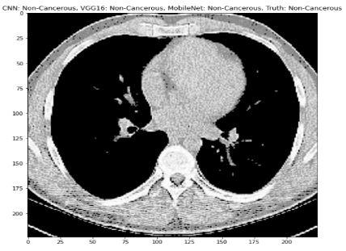
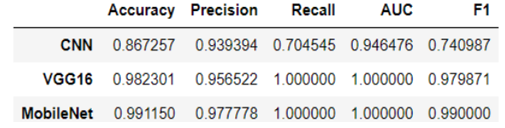
Result
It is noticeable that CNN, MOBILENET and VGG-16 are able to detect that the lung is cancerous or non-cancerous properly.
But according to the scores it is clear that MOBILENET and VGG-16 is better accurate in terms of detection and their score is more higher than normal convolutional neural network.

Slide 18


